Slide 1
CSE340: Computer Architecture
Chapter - 1: Computer Abstractions and Technology

Slide 2
Understanding Performance
Hardware or Software Component | How this component affects performance? | Where to learn?
Algorithm | Determines both the number of source-level statements and the number of I/O operations executed. | Covered in CSE221
Programming Language, Compiler and architecture | Determines the number of computer instructions for each source-level statement. | Chapter 2 & 3
Processor and memory system | Determines how fast instructions can be executed | Chapter 4, 5 & 6
I/O system (Hardware and OS) | Determines how fast I/O operations may be executed | Chapter 4, 5 & 6
Notes:
Morgan Kaufmann Publishers
*
Chapter 1 — Computer Abstractions and Technology
‹#›

Slide 3
Seven Great Ideas in Computer Architecture
Ideas | Explanation
Use abstraction to simplify design | Divide systems into layers to manage complexity and hiding the lower level details.
Make the common case fast | Optimizing frequently performed operations.
Performance via parallelism | Running tasks simultaneously to boost speed.
Performance via pipelining | A way to achieve parallelism. More will be discussed in Chapter - 4
Performance via prediction | Anticipate future data or values to avoid delays.
Hierarchy of memories | Organizing memory into levels (registers, cache, RAM, storage) based on speed and size.
Dependability via redundancy | Adding extra components ensures reliability by compensating for failures in critical hardware or data.
Notes:
Morgan Kaufmann Publishers
*
Chapter 1 — Computer Abstractions and Technology
‹#›

Slide 4
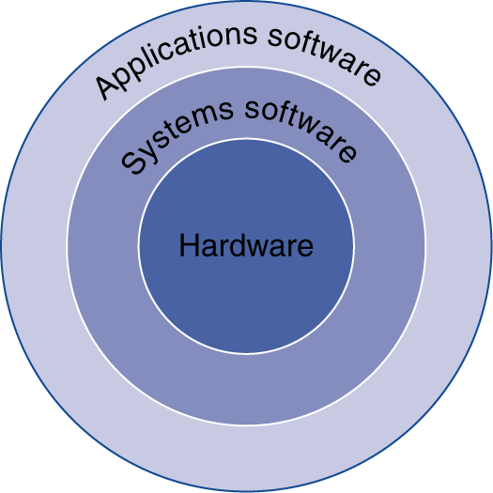
Below Your Program
Application software
Written in high-level language
System software
Compiler: translates HLL code to machine code
Operating System: service code
Handling input/output
Managing memory and storage
Scheduling tasks & sharing resources
Hardware
Processor, memory, I/O controllers
Notes:
Morgan Kaufmann Publishers
*
Chapter 1 — Computer Abstractions and Technology
‹#›

Slide 5
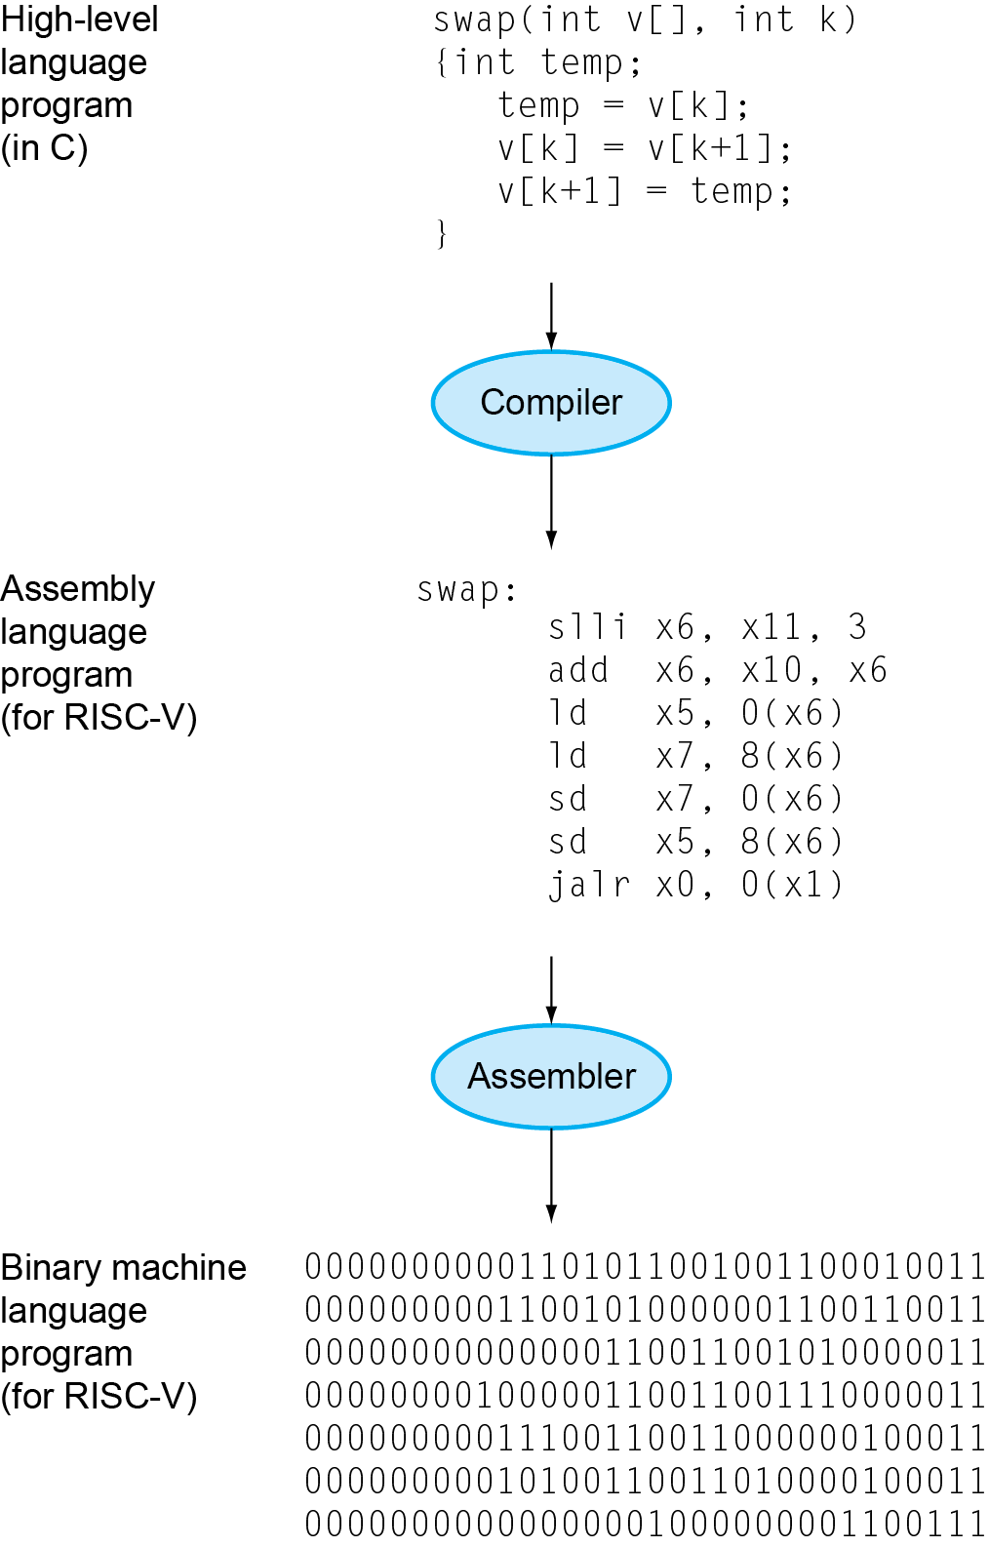
Levels of Program Code
High-level language
Level of abstraction closer to problem domain
Provides for productivity and portability
Assembly language
Textual representation of instructions
Hardware representation
Binary digits (bits)
Encoded instructions and data
Notes:
Morgan Kaufmann Publishers
*
Chapter 1 — Computer Abstractions and Technology
‹#›

Slide 6
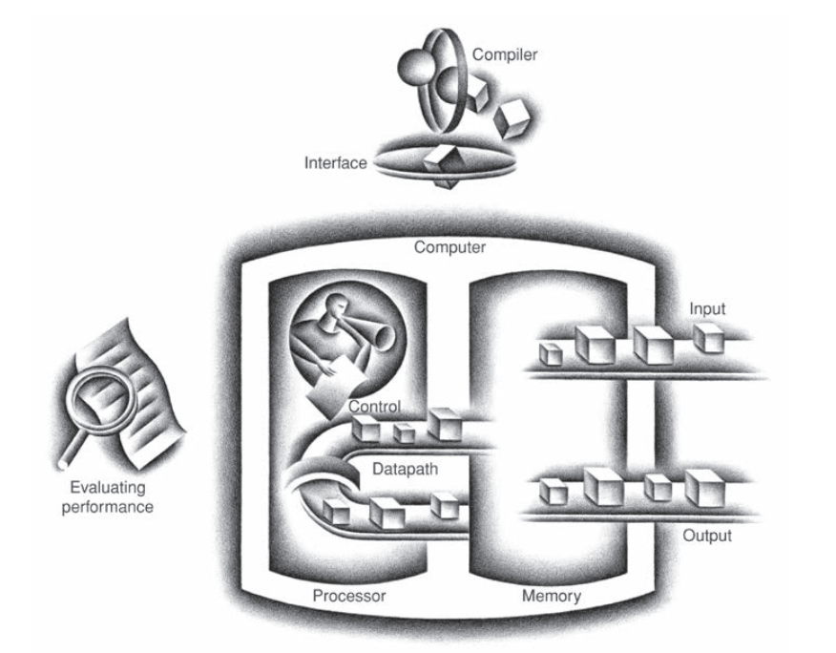
Components of a Computer
The five classic components of a computer are:
Input
Output
Memory
Datapath
Control
Datapath and control are sometimes combined and called the processor.
Figure: The standard organization of a computer
Notes:
Morgan Kaufmann Publishers
*
Chapter 1 — Computer Abstractions and Technology
‹#›

Slide 7
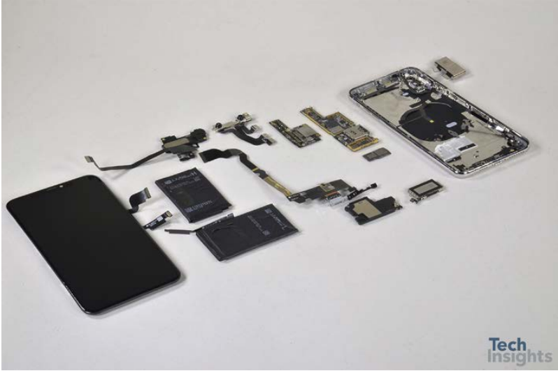
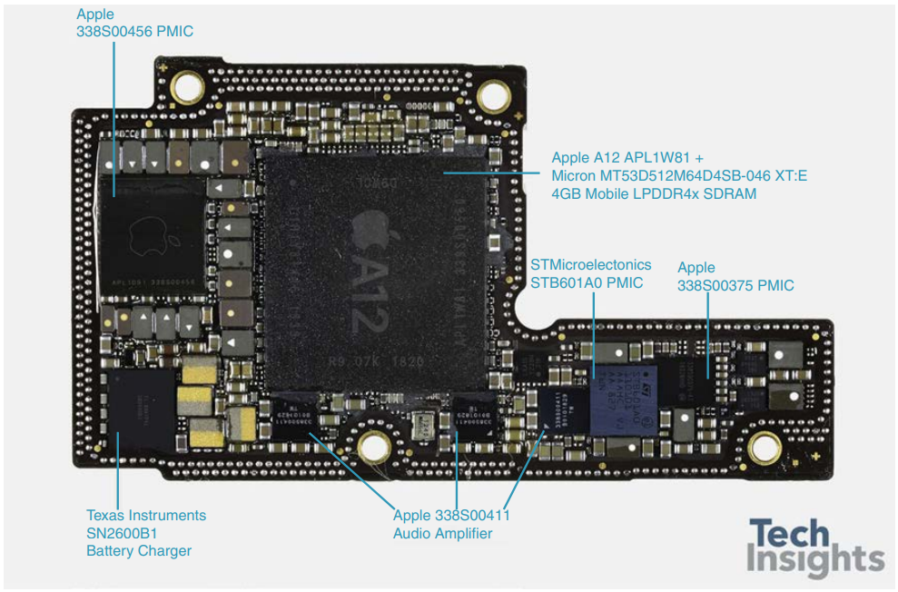
Opening the Box
Figure: Components of the Apple iPhone XS Max
Figure: Logic board of the Apple iPhone XS Max
Notes:
Morgan Kaufmann Publishers
*
Chapter 1 — Computer Abstractions and Technology
‹#›

Slide 8
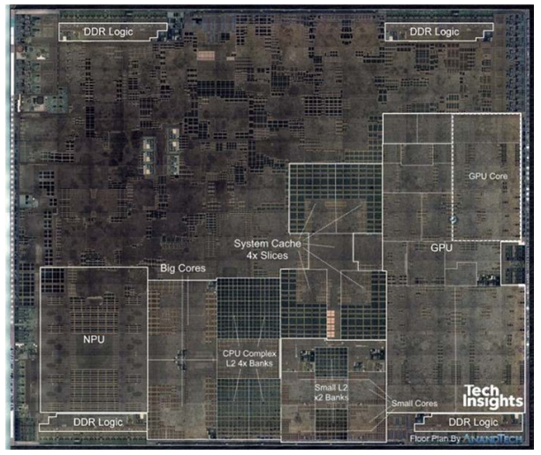
Opening the Box
Figure: The processor integrated circuit inside the A12 package
Notes:
Morgan Kaufmann Publishers
*
Chapter 1 — Computer Abstractions and Technology
‹#›

Slide 9
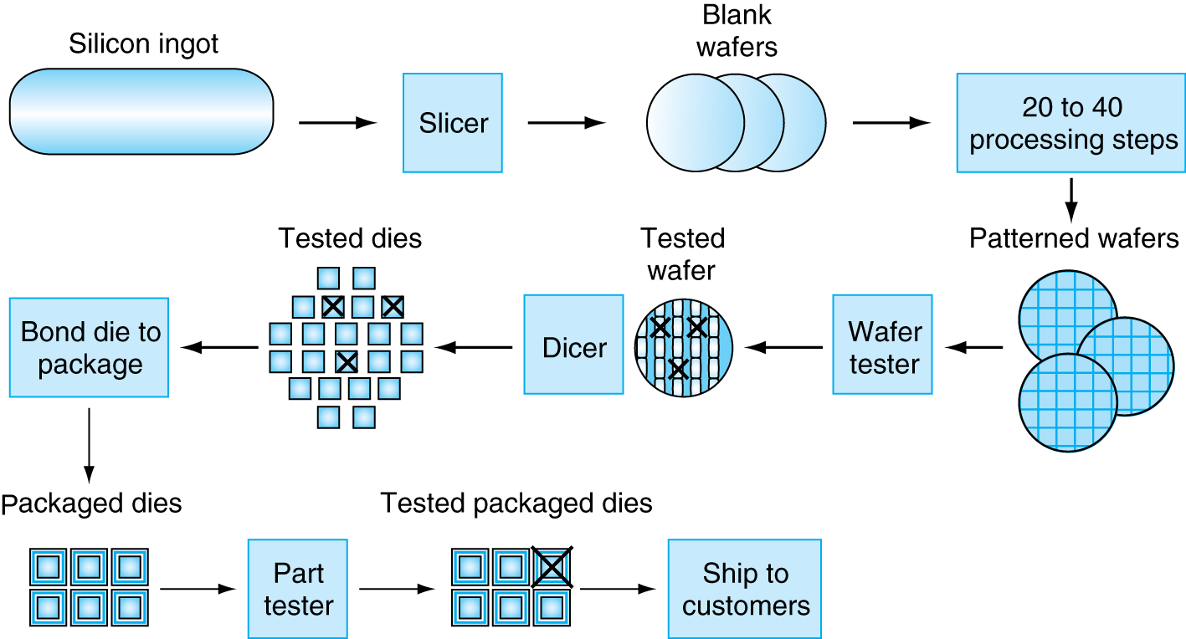
Technologies for Building Processors
Figure: Manufacturing process of an IC
Notes:
Morgan Kaufmann Publishers
*
Chapter 1 — Computer Abstractions and Technology
‹#›

Slide 10
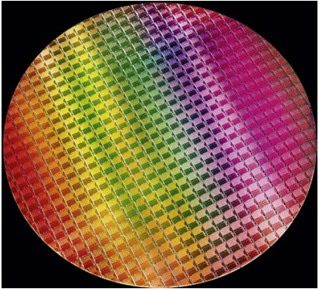
Intel 10th Gen. Wafer
This 10nm wafer contains 10th Gen Intel® Core™ processors, code-named “Ice Lake” (Courtesy Intel).
The number of dies on this 300 mm (12 inch) wafer at 100% yield is 506.
Each die or chip size = 11.4mm by 10.7mm
Yield: The percentage of good dies from the
total number of dies on the wafer.
Die: The individual rectangular sections that
are cut from a wafer, more informally
known as chips.
Figure: A 12-inch (300mm) wafer
Notes:
Morgan Kaufmann Publishers
*
Chapter 1 — Computer Abstractions and Technology
‹#›

Slide 11
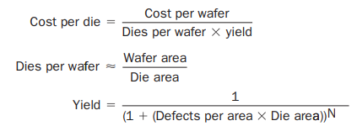
IC Cost Calculation
Note: N in the yield formula is a model parameter that determines how defects and die size impact yield. It is typically derived from real-world data and can range between 1 and 2, though it may vary outside this range depending on the technology and defect behavior.
Nonlinear relation to area and defect rate
Wafer cost and area are fixed
Defect rate determined by manufacturing process
Die area determined by architecture and circuit design
Notes:
Morgan Kaufmann Publishers
*
Chapter 1 — Computer Abstractions and Technology
‹#›

Slide 12
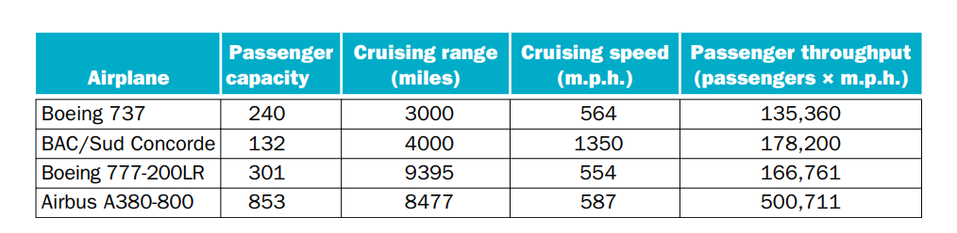
Defining Performance
Based on the table below which airplane has the best performance?
Figure: The capacity, range, and speed for a number of commercial airplanes
Notes:
Morgan Kaufmann Publishers
*
Chapter 1 — Computer Abstractions and Technology
‹#›

Slide 13
Response Time and Throughput
Response time: The time between the start and completion of a task. Also
known as execution time.
Throughput: Total work done per unit time.
e.g., tasks/transactions/… per hour
We’ll focus on response time for now…
Answer yourself:
How are response time and throughput affected by,
Replacing the processor with a faster version?
Adding additional processors to a system that uses multiple processors
for separate tasks?
Notes:
Morgan Kaufmann Publishers
*
Chapter 1 — Computer Abstractions and Technology
‹#›

Slide 14

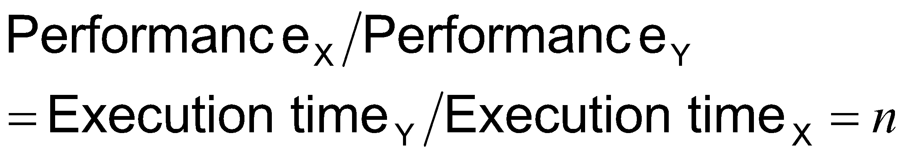
Relative Performance
To maximize performance, we want to minimize the response/execution time for a task.
The relation between performance and execution time for computer X:
“X is n time faster than Y”
Example: time taken to run a program 10s on A, 15s on B
Execution Time_{B} / Execution Time_{A} = 15s / 10s = 1.5
So A is 1.5 times faster than B
Notes:
Morgan Kaufmann Publishers
*
Chapter 1 — Computer Abstractions and Technology
‹#›

Slide 15
Measuring Execution Time
Elapsed time: Total response time, including all aspects. E.g Processing,
I/O, OS overhead, idle time etc.
Determines system performance
CPU time: The actual time the CPU spends computing for a specific task.
Discounts I/O time, other jobs’ shares
Comprises user CPU time and system CPU time
Different programs are affected differently by CPU and system performance
Notes:
Morgan Kaufmann Publishers
*
Chapter 1 — Computer Abstractions and Technology
‹#›

Slide 16
CPU Clocking
Operation of digital hardware governed by a constant-rate clock.
Clock period
Clock (cycles)
Data transfer and computation
Update state
Clock period: Time taken to complete a clock cycle
e.g., 250ps = 0.25ns = 250×10^{–12}s
Clock frequency (rate): Clock cycles completed per second
e.g., 4.0GHz = 4000MHz = 4.0×10⁹Hz
Notes:
Morgan Kaufmann Publishers
*
Chapter 1 — Computer Abstractions and Technology
‹#›

Slide 17
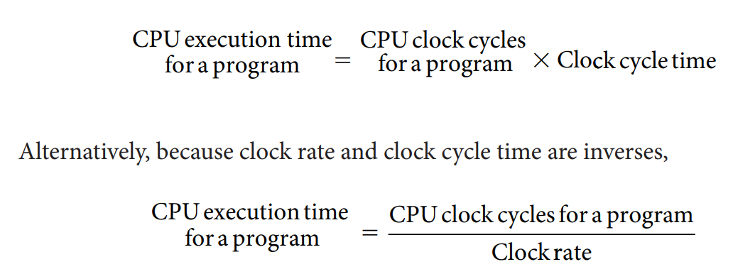
CPU Performance and Its Factors
Answer yourself: Analyze the formula mentioned above and determine how can you improve the performance of a program?
Notes:
Morgan Kaufmann Publishers
*
Chapter 1 — Computer Abstractions and Technology
‹#›

Slide 18
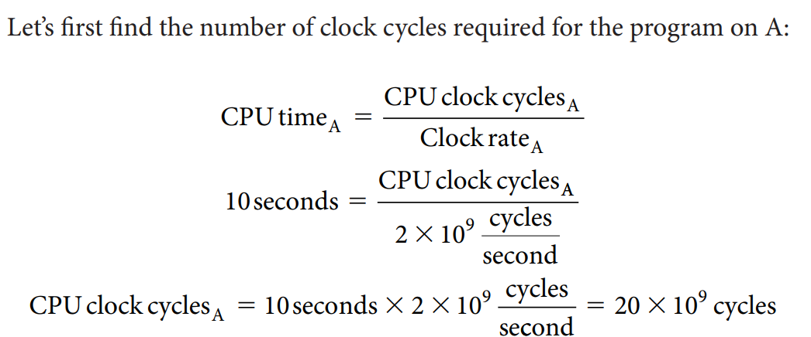
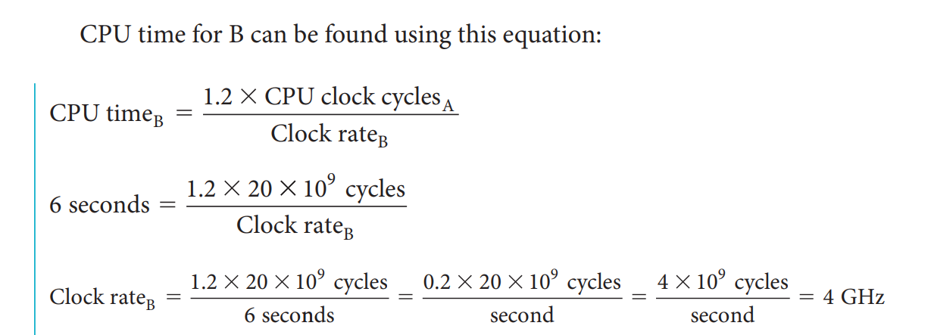
CPU Performance Example
Problem statement: A program runs in 10 seconds on computer A, which has a 2GHz clock. We are trying to help a computer designer build a computer, B, which will run this program in 6 seconds. The designer has determined that a substantial increase in the clock rate is possible, but this increase will affect the rest of the CPU design, causing computer B to require 1.2 times as many clock cycles as computer A for this program. What clock rate should we tell the designer to target?
Solution:
Notes:
Morgan Kaufmann Publishers
*
Chapter 1 — Computer Abstractions and Technology
‹#›

Slide 19
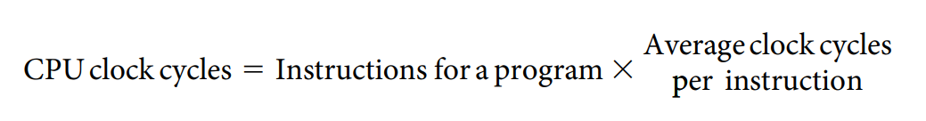
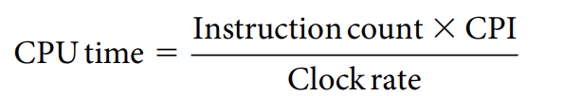
Instruction Count and CPI
Instruction Count for a program
Determined by program, ISA and compiler
Average cycles per instruction
Determined by CPU hardware
If different instructions have different CPI
Average CPI affected by instruction mix
Notes:
Morgan Kaufmann Publishers
*
Chapter 1 — Computer Abstractions and Technology
‹#›

Slide 20
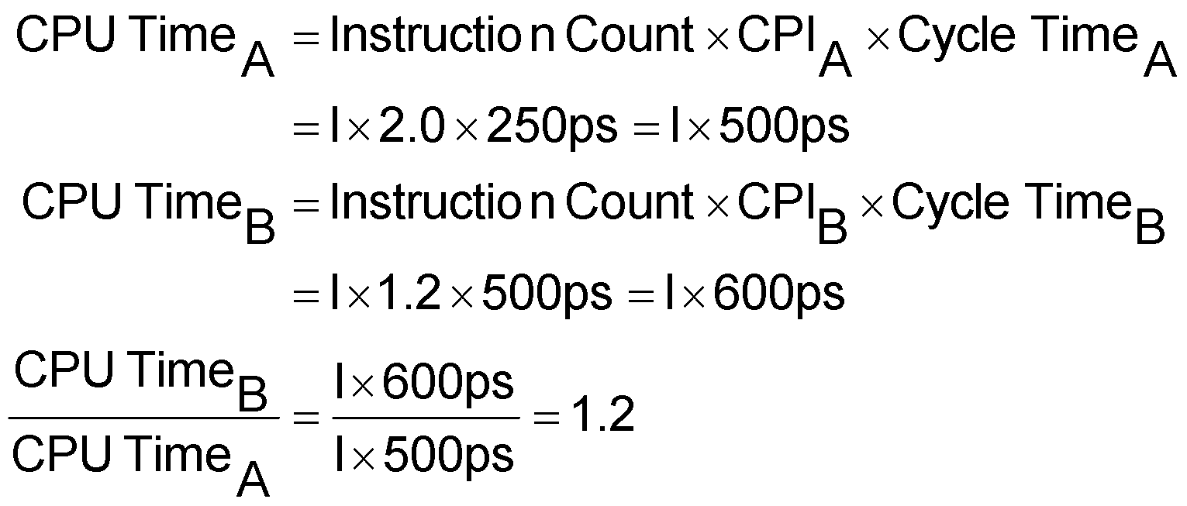
Instruction Count & CPI Example
Computer A: Cycle Time = 250ps, CPI = 2.0
Computer B: Cycle Time = 500ps, CPI = 1.2
Same ISA
Which is faster, and by how much?
Answer yourself: Why we assumed that the instruction count is same in both cases?
So, A is 1.2 times faster
Notes:
Morgan Kaufmann Publishers
*
Chapter 1 — Computer Abstractions and Technology
‹#›

Slide 21
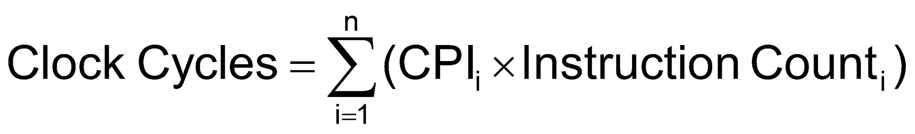
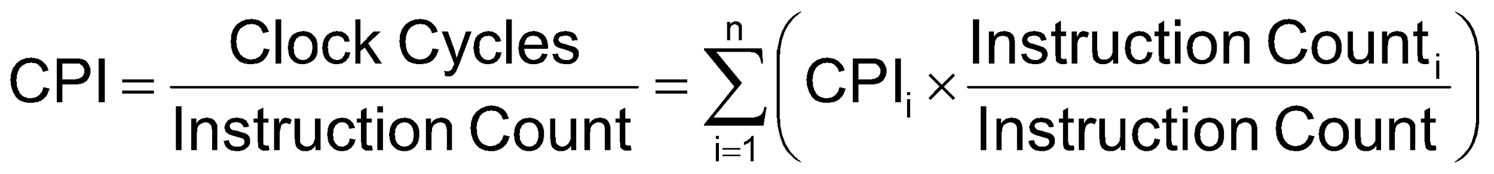
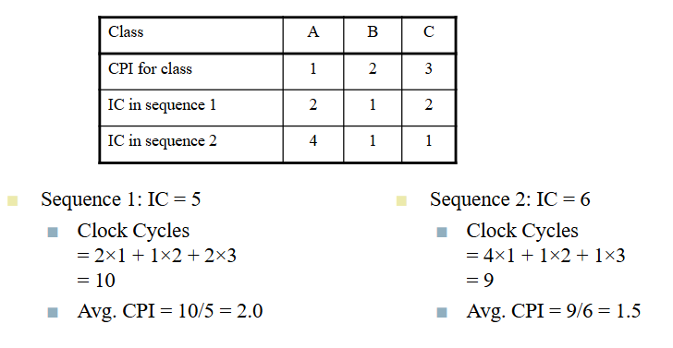
Average CPI with Example
If different instruction classes take different numbers of cycles
Weighted average CPI
Problem Statement:
Alternative compiled code sequences using instructions in classes A, B, C
Solution:
Notes:
Morgan Kaufmann Publishers
*
Chapter 1 — Computer Abstractions and Technology
‹#›

Slide 22
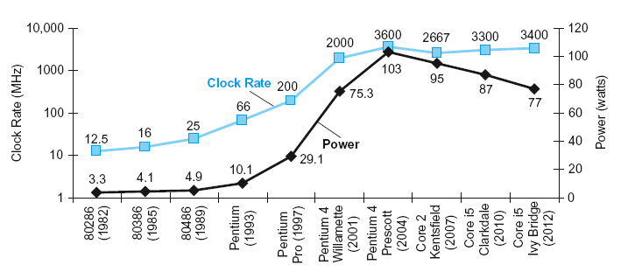
Power Trends
In CMOS IC technology
Notes:
Morgan Kaufmann Publishers
*
Chapter 1 — Computer Abstractions and Technology
‹#›

Slide 23
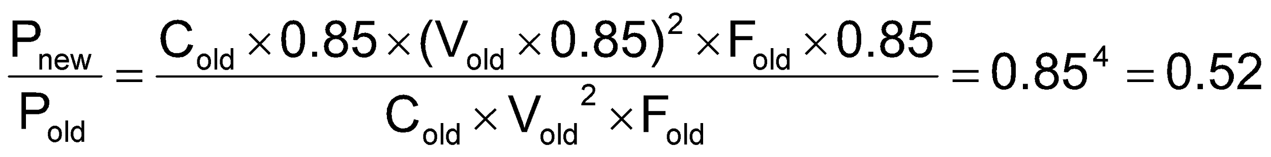
Reducing Power
Suppose a new CPU has
85% of capacitive load of old CPU
15% voltage and 15% frequency reduction
The power wall
We can’t reduce voltage further
We can’t remove more heat
Answer yourself:
How else can we improve performance?
Notes:
Morgan Kaufmann Publishers
*
Chapter 1 — Computer Abstractions and Technology
‹#›

Slide 24
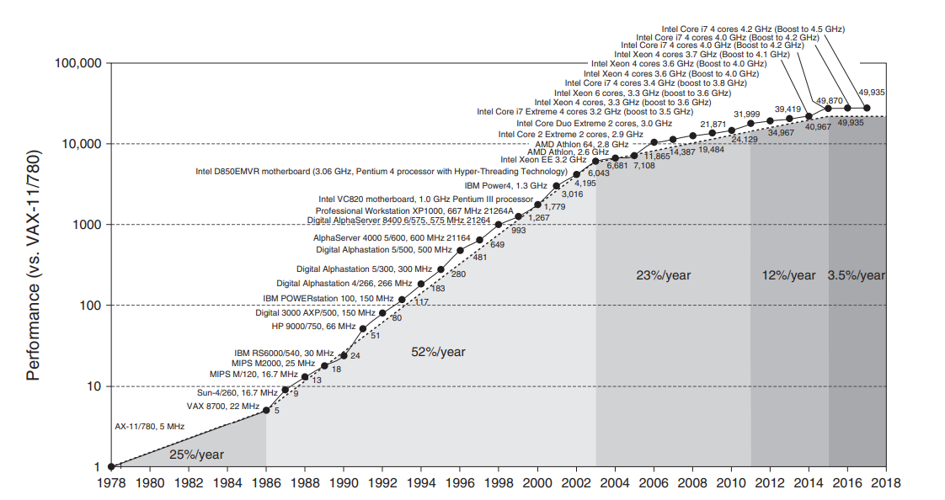
Uniprocessor Performance
Figure: Growth in processor performance since the mid-1980s
Constrained by power, instruction-level parallelism, memory latency
Notes:
Morgan Kaufmann Publishers
*
Chapter 1 — Computer Abstractions and Technology
‹#›

Slide 25
Multiprocessors
Multicore microprocessors
More than one processor per chip
Requires explicitly parallel programming
Compare with instruction level parallelism
Hardware executes multiple instructions at once
Hidden from the programmer
Hard to do
Programming for performance
Load balancing
Optimizing communication and synchronization
Chapter 1 — Computer Abstractions and Technology — ‹#›
Notes:
Morgan Kaufmann Publishers
*
Chapter 1 — Computer Abstractions and Technology
‹#›

Slide 26
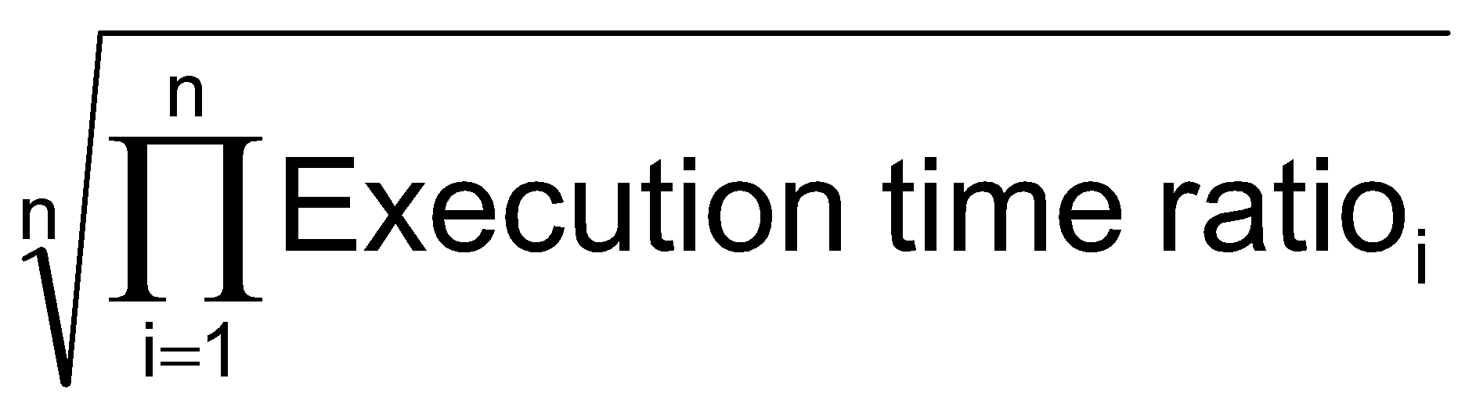
SPEC CPU Benchmark
What is Benchmark?
Programs used to measure performance
Standard Performance Evaluation Corp (SPEC)
Develops benchmarks for CPU, I/O, Web, …
SPEC CPU2017
Elapsed time to execute a selection of programs
Negligible I/O, so focuses on CPU performance
Normalize relative to reference machine
Summarize as geometric mean of performance ratios
SPECspeed2017 (integer) and CFP2006 (floating-point)
Notes:
Morgan Kaufmann Publishers
*
Chapter 1 — Computer Abstractions and Technology
‹#›

Slide 27
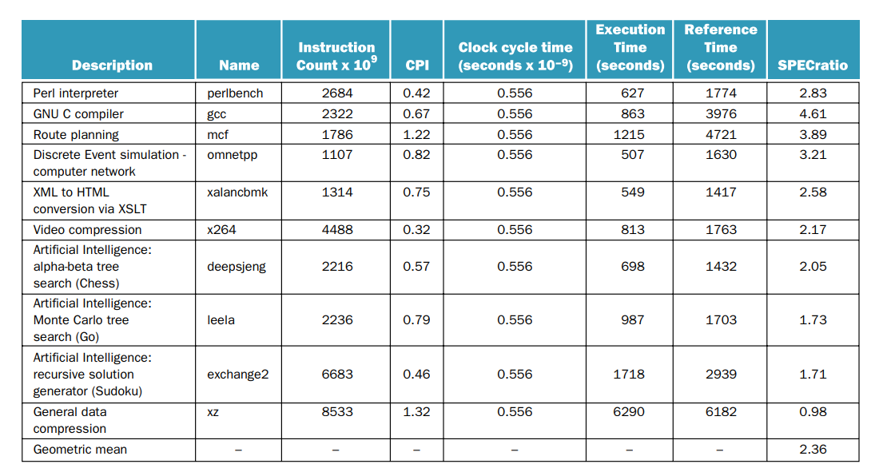
SPEC Ratio & Geometric Mean Calculation
Note:
Reference time is supplied by SPEC
Notes:
Morgan Kaufmann Publishers
*
Chapter 1 — Computer Abstractions and Technology
‹#›

Slide 28

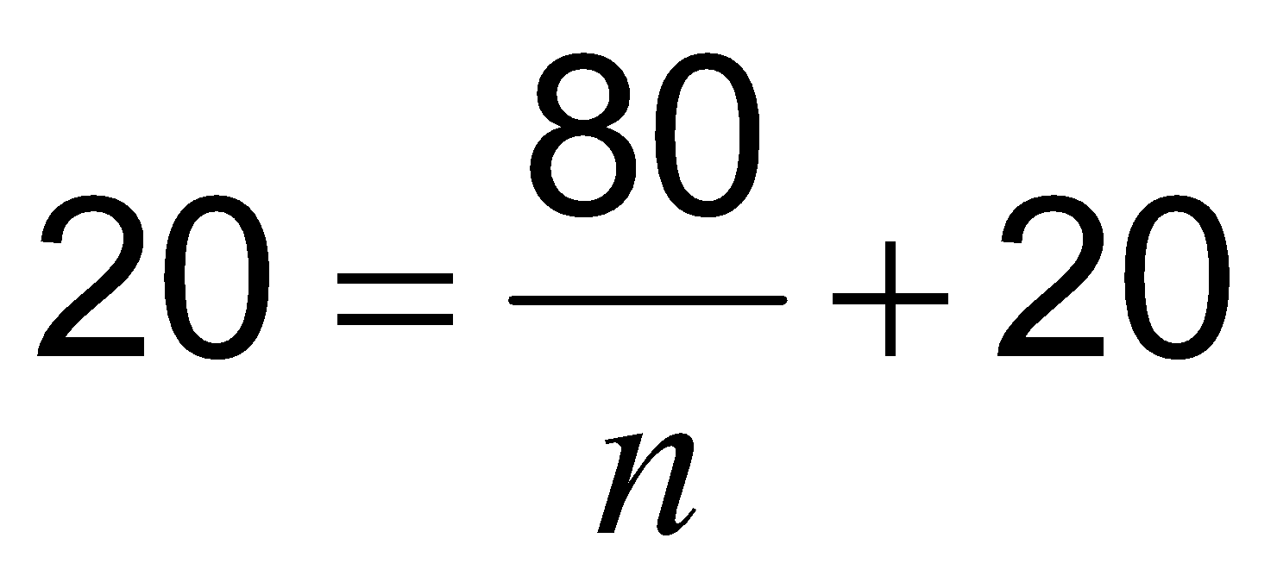
Amdahl’s Law
Improving an aspect of a computer and expecting a proportional improvement in overall performance
Example: multiply accounts for 80s/100s
How much improvement in multiply performance to get 5× overall?
Can’t be done!
Corollary: make the common case fast
Notes:
Morgan Kaufmann Publishers
*
Chapter 1 — Computer Abstractions and Technology
‹#›

Slide 29
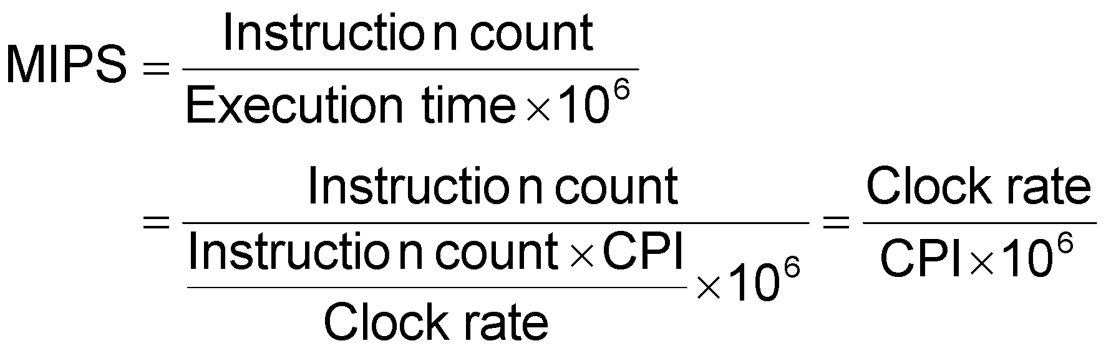
MIPS as a Performance Metric
MIPS: Millions of Instructions Per Second
Doesn’t account for
Differences in ISAs between computers
Differences in complexity between instructions
CPI varies between programs on a given CPU
Notes:
Morgan Kaufmann Publishers
*
Chapter 1 — Computer Abstractions and Technology
‹#›

Slide 30
Concluding Remarks
Cost/performance is improving
Due to underlying technology development
Hierarchical layers of abstraction
In both hardware and software
Instruction set architecture
The hardware/software interface
Execution time: the best performance measure
Power is a limiting factor
Use parallelism to improve performance
Notes:
Morgan Kaufmann Publishers
*
Chapter 1 — Computer Abstractions and Technology
‹#›

